Slide 1
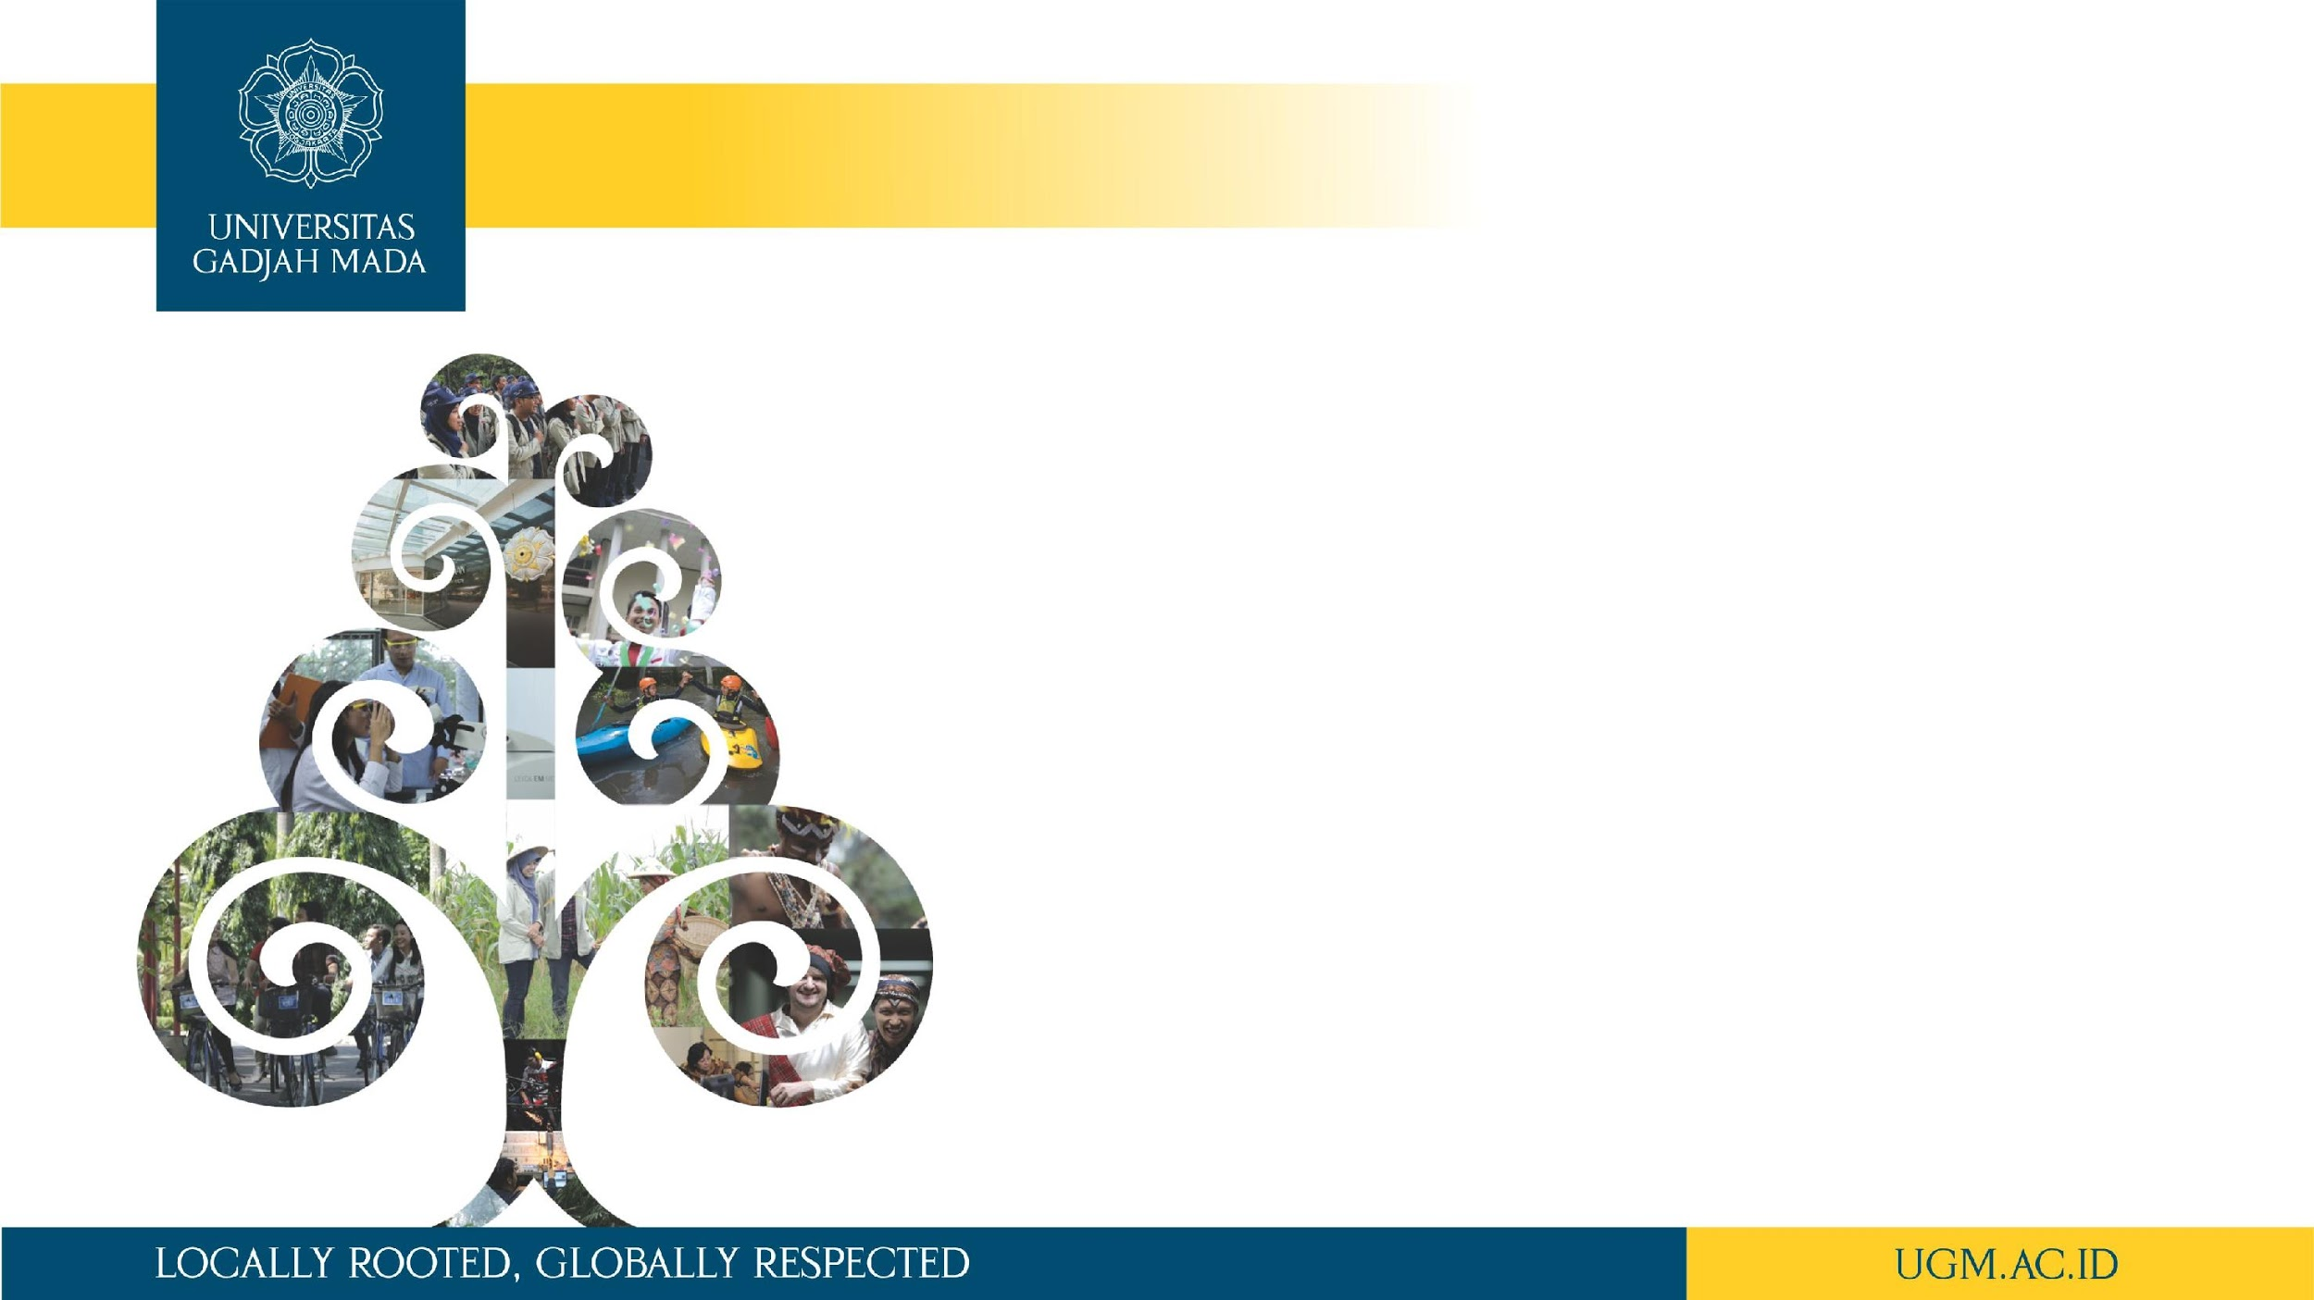
Introduction to Clustering
Afiahayati, Ph.D.
Dept. of Computer Science and Electronics
Universitas Gadjah Mada
afia@ugm.ac.id

Slide 2
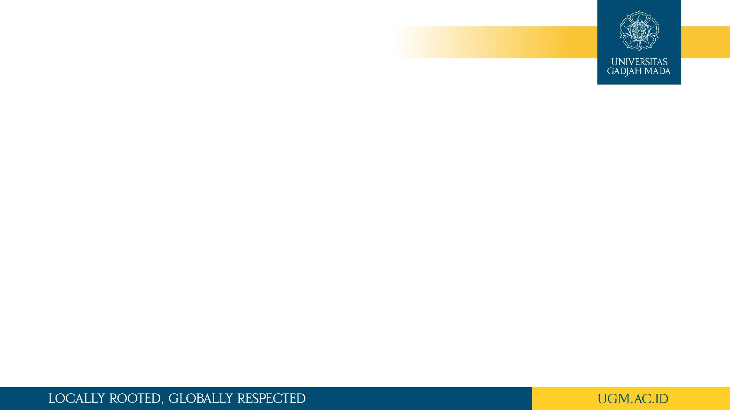
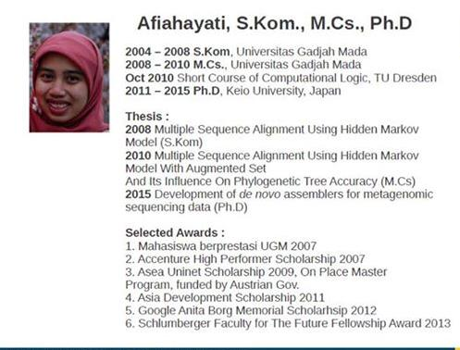

Slide 3
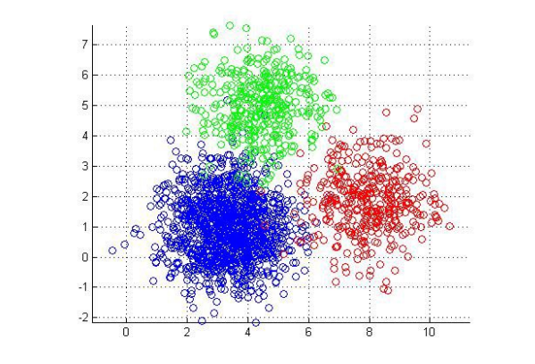
Unsupervised Learning

Slide 4
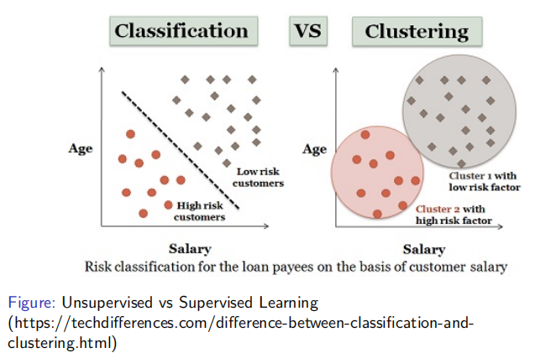
Supervised vs Unsupervised Learning

Slide 5
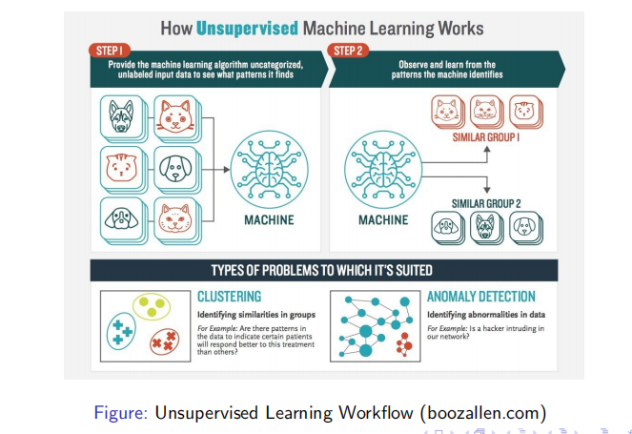
Unsupervised Learning Workflow

Slide 6
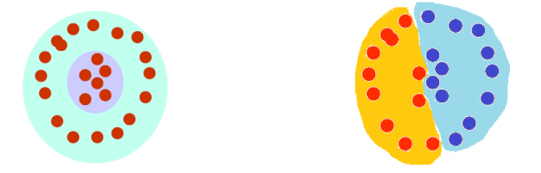
Clustering - what is it?
The organization of unlabeled data into similarity groups called clusters.
A cluster is a collection of data items which are “similar” between them, and “dissimilar” to data items in other clusters.
http://www.mit.edu/~9.54/fall14/slides/Class13.pdf

Slide 7
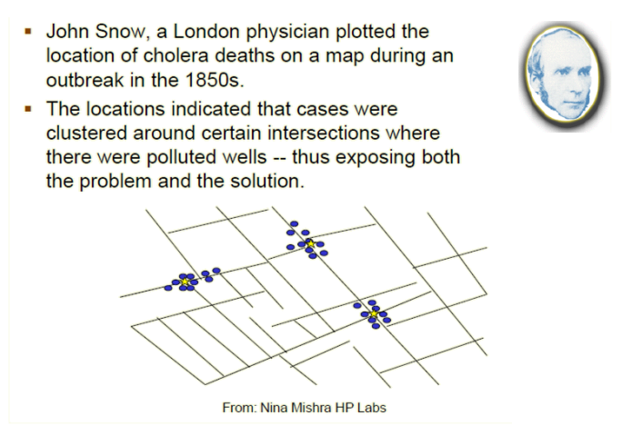
Historic Application of Clustering

Slide 8

An Application of Clustering
Object Detection => image segmentation
Object detection and Image Classification by an Autonomous Vehicle
https://towardsdatascience.com/introduction-to-image-segmentation-with-k-means-clustering-83fd0a9e2fc3

Slide 9
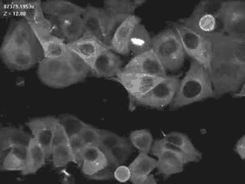
An Application of Clustering
Object Detection => image segmentation
Breast Cancer
https://towardsdatascience.com/introduction-to-image-segmentation-with-k-means-clustering-83fd0a9e2fc3

Slide 10
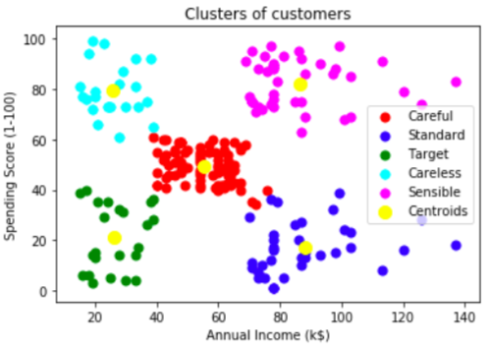
An Application of Clustering
Clusters of Customers

Slide 11
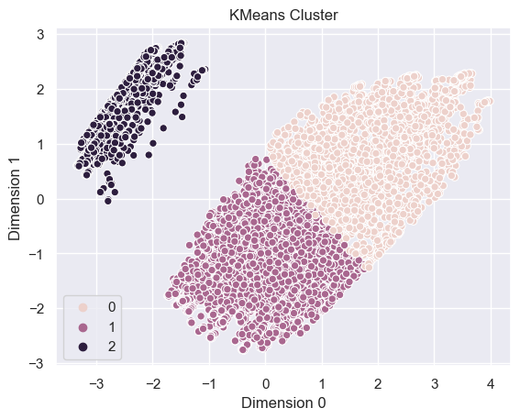
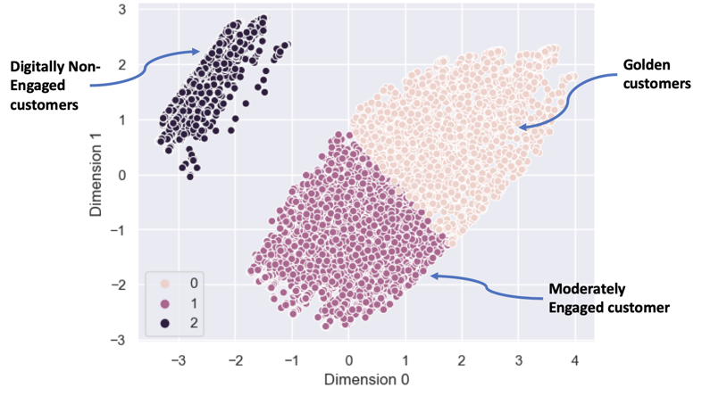
Interpreting Clustering
(hard task…)

Slide 12
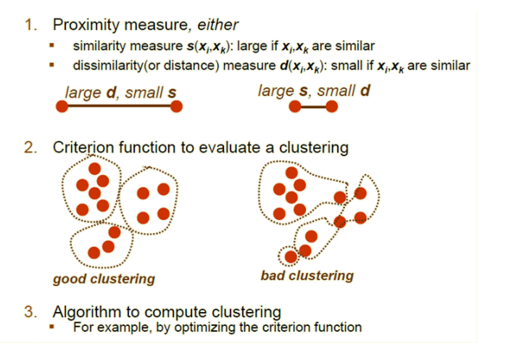
What do we need for Clustering?

Slide 13
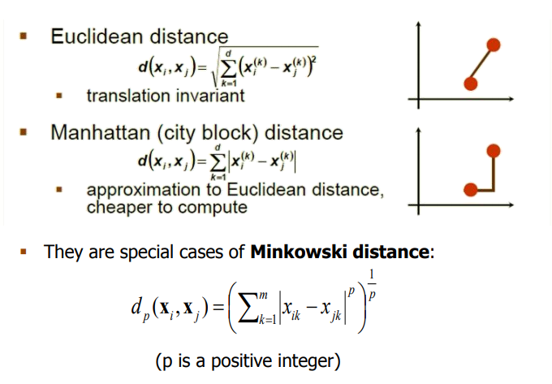
Distance (dissimilarity) measures

Slide 14
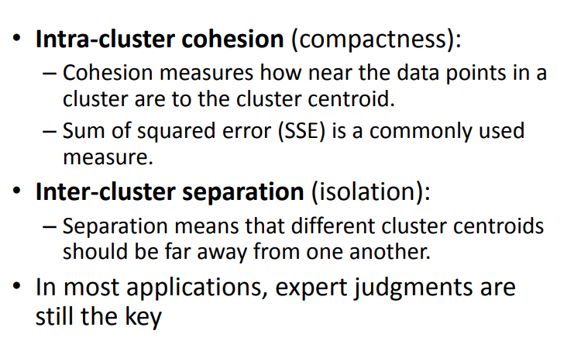
Cluster Evaluation ???

Slide 15
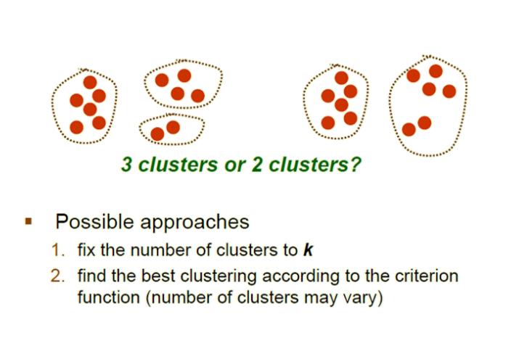
How many clusters?

Slide 16
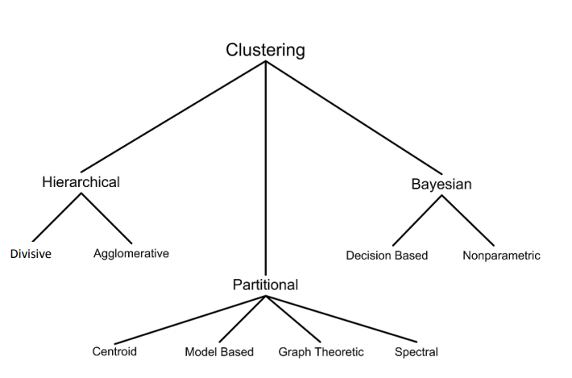
Clustering techniques

Slide 17
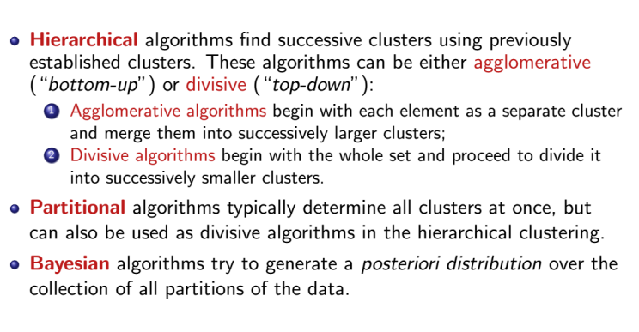
Clustering techniques

Slide 18
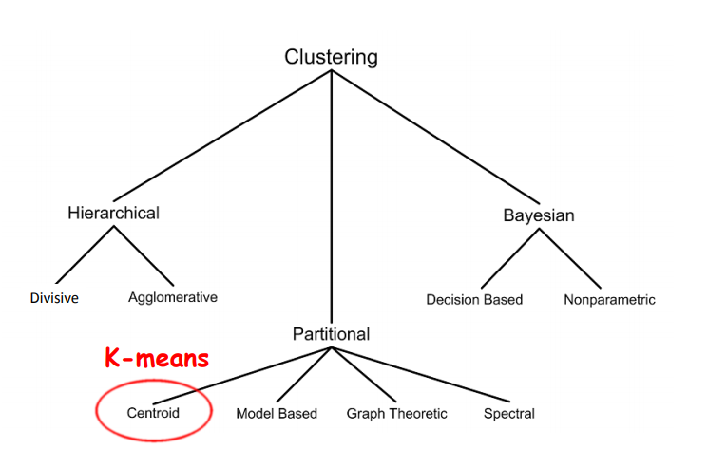
Clustering techniques

